Slide 1
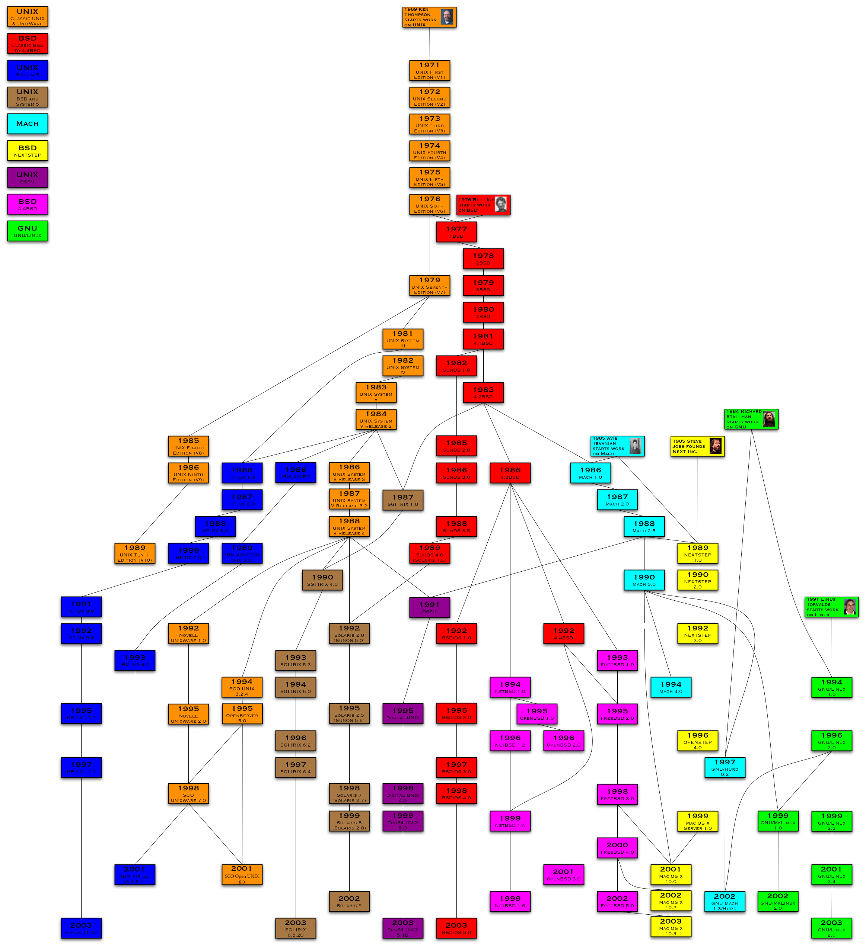
History of Unix
Craig Hollabaugh
Western Slope Developers
Meetup March 2nd 2017

Slide 2
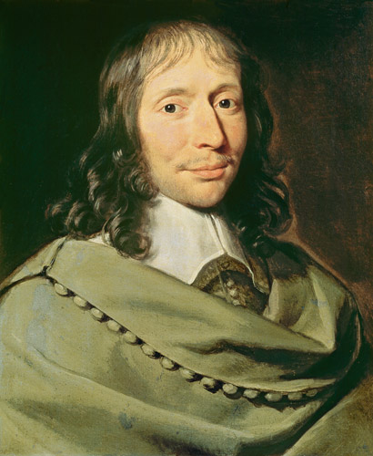
A Computer
In 1613, a person who computes
Blaise Pascal
1623-1662

Slide 3
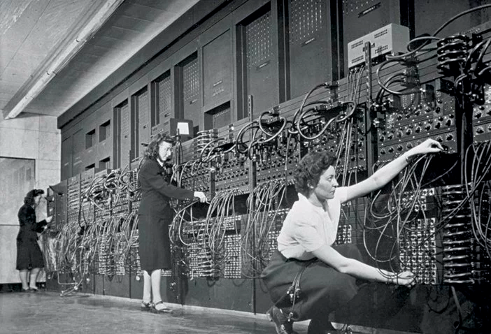
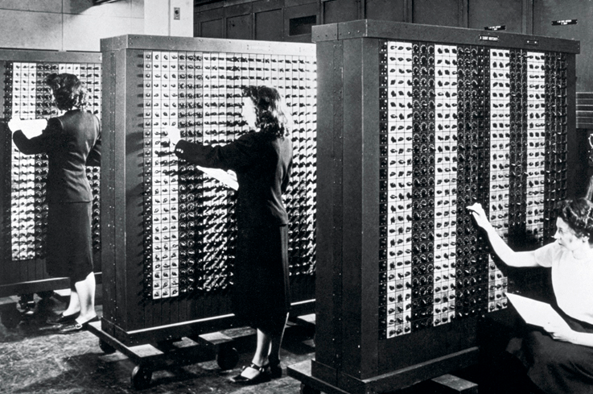
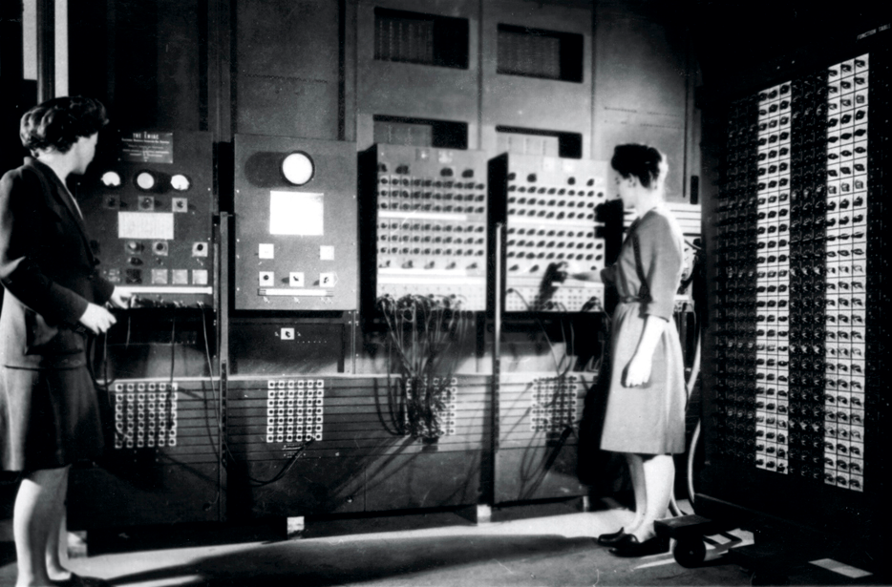
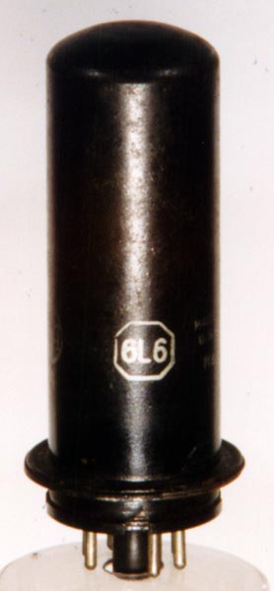
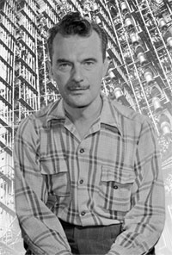
Kay McNulty, Betty Snyder, Marlyn Wescoff,
Ruth Lichterman, Betty Jean Jennings, and Fran Bilas
ENIAC Girls
The first US programmers
Who Was Nick Metropolis?
His problem used 1 million cards
18k tubes, 60klbs, 150kW
100kHz clock, failed every 2 days

Slide 4

Bell Labs and the 1956 Consent Decree
Allowed AT&T to remain a vertically integrated monopoly but had to license all Bell Labs patents royalty free.

Slide 5
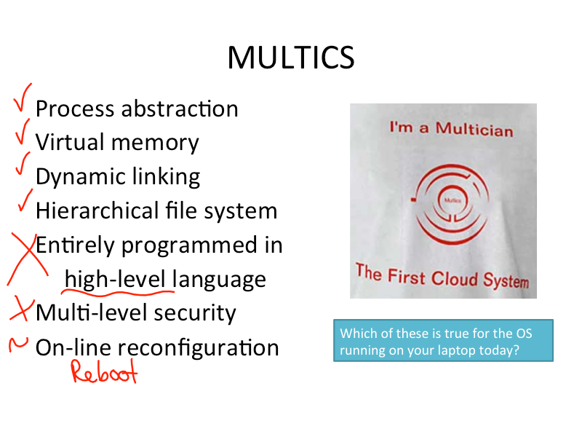
Multics
MIT, Bell Labs and GE - 1964

Slide 6
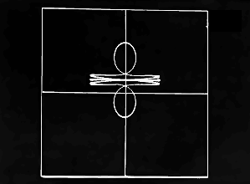
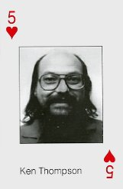
Space Travel - 1969

Slide 7
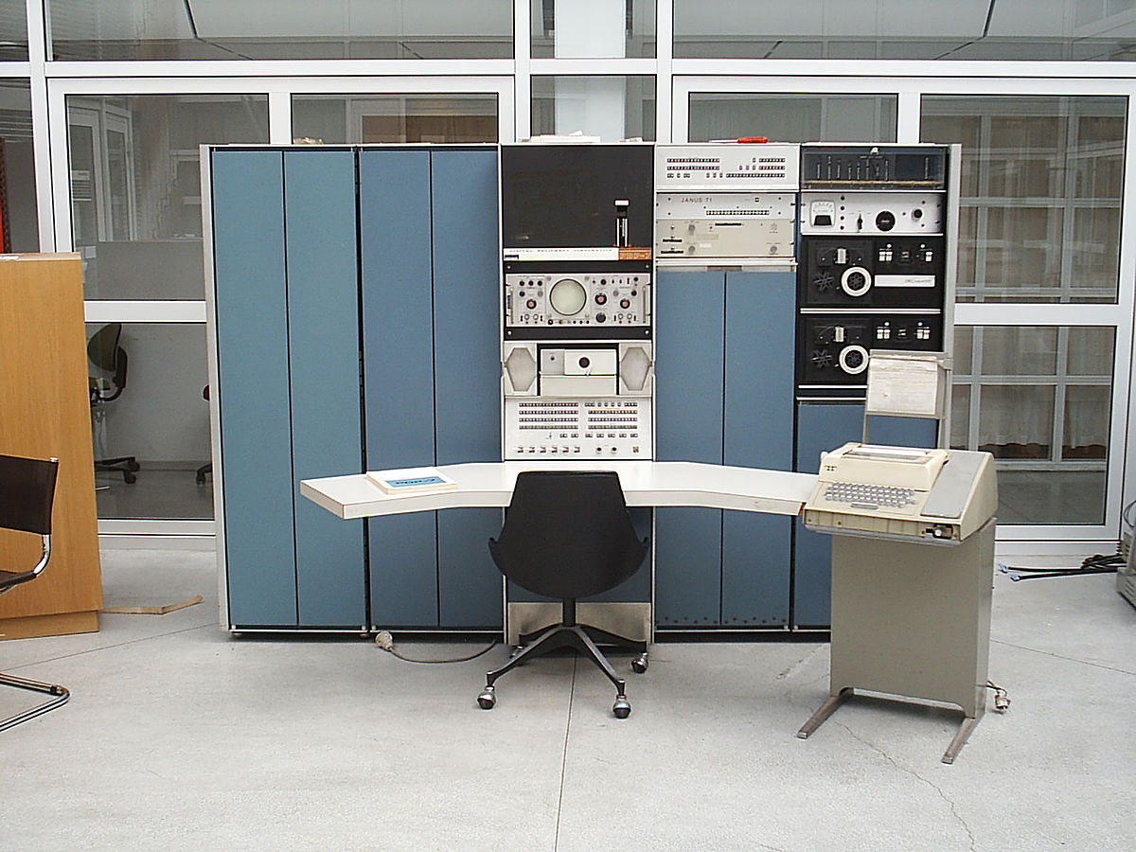
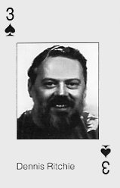
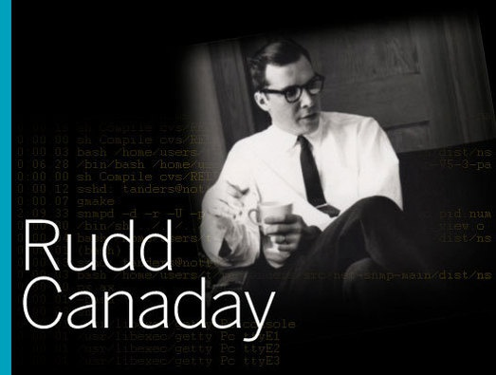
DEC PDP-7 Unix 1969
Smaller than multics, in one month running OS with assembler, editor, shell
Unics (UNiplexed Information and Computing Service)
9kB of memory, paper or DECtape, $550K 2016 dollars
120 made and sold
1969 Bell Labs team including Thompson, Richie, Canaday dev of HFS, processes, device files, and command-line
Kernigan terms Unix

Slide 8

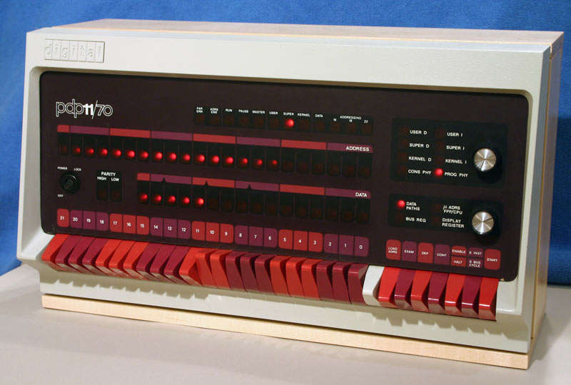
VAX - PDP-11 - 1970
DEC sells a total of 600,000 PDP-11s from 1970 to 1990. $66K in 2016 dollars.
C first developed on PDP-11. Unix rewritten in C.
Dennis Ritchie and Ken Thompson at the PDP-11.

Slide 9
Unix Philosophy
DOTADIW
KISS
Exercise for You!
Read Eric Raymond's 17 Unix Rules

Slide 10
Do One Thing and Do It Well
adb ar as atob awk bash bc bsh btoa c89 cal cat cb cc chgrp chmod chown chsh ci cmp co comm cp cpio cpp cron csh dbx dc dd df diff diff3 dirname du ed egrep elm emacs eqn eval ex expr fc fgrep fmt fsck ftio ftp fuser getty grep id imake irc jsh ksh ld lex lint lharc ln logname lorder lpc lpd lpq lpr lprm ls m4 man mkfs mknod mv mvdir mwm nawk nl nm nn nohup nroff oclock od passwd pax pcc pg pgp pico pine ping povray pr prs prof ps pwd qdaemon ranlib rcp rcs rlogin rm rmdel rmail rmdir rmt rsh roff rz sar sdb sed sh shar stty su sync sz tar tbl tclsh tcsh tee telnet tex tr troff tsh tsort ttt ulimit uname uniq uucp vi vim wall wc who wish wm xargs xdm xdpr xfd xmkmf xrdb xwd xwud yacc zip

Slide 11
Licensing
1956 Bell anti-trust lawsuit
Could only be a phone company
Licensing and selling media was OK
1973 v5 licensed to education
1975 v6 commercial
License was $90K in 2016 dollars
Sidenote
1975 Microsoft founded in Albuquerque

Slide 12
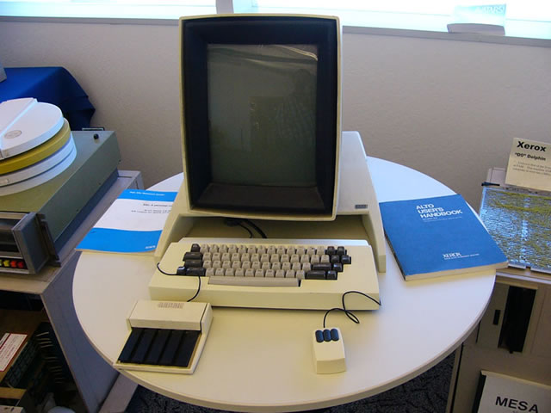
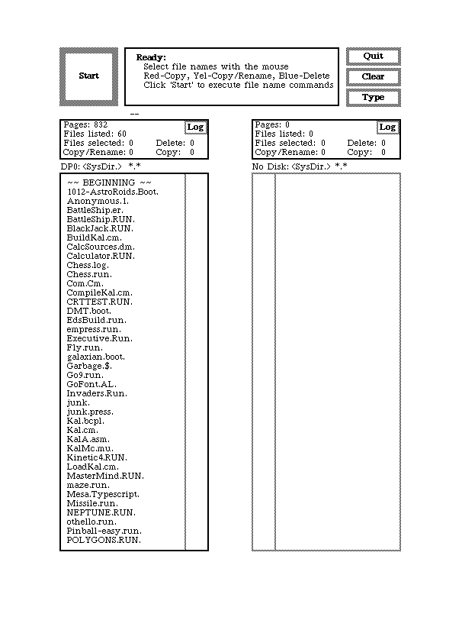
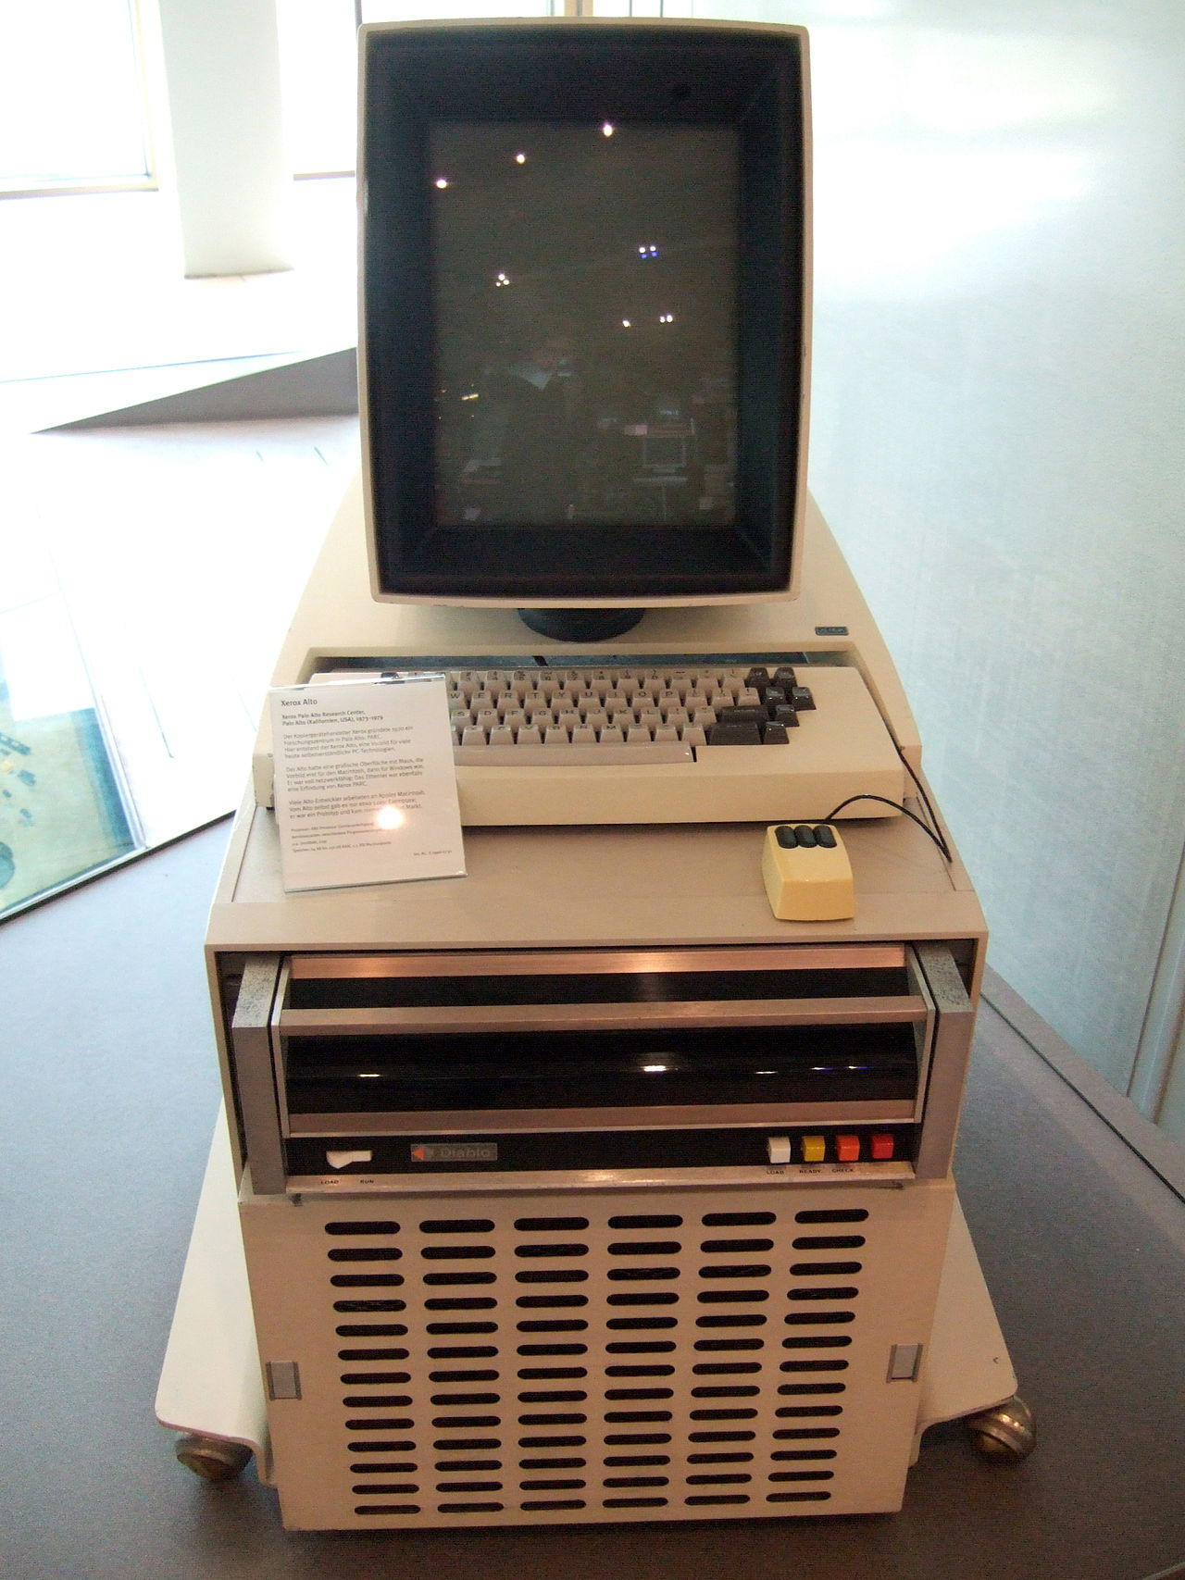
Xerox Alto - 1973
Touchpad and 3-button mouse based on Engelbart's 1968 demo
Xerox also invents Ethernet and the laser printer at the same time.
Doesn't run Unix

Slide 13
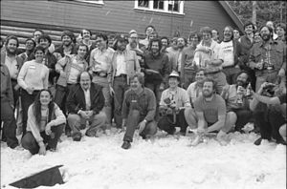
First Unix Meetup
1974 USENIX New York

Slide 14
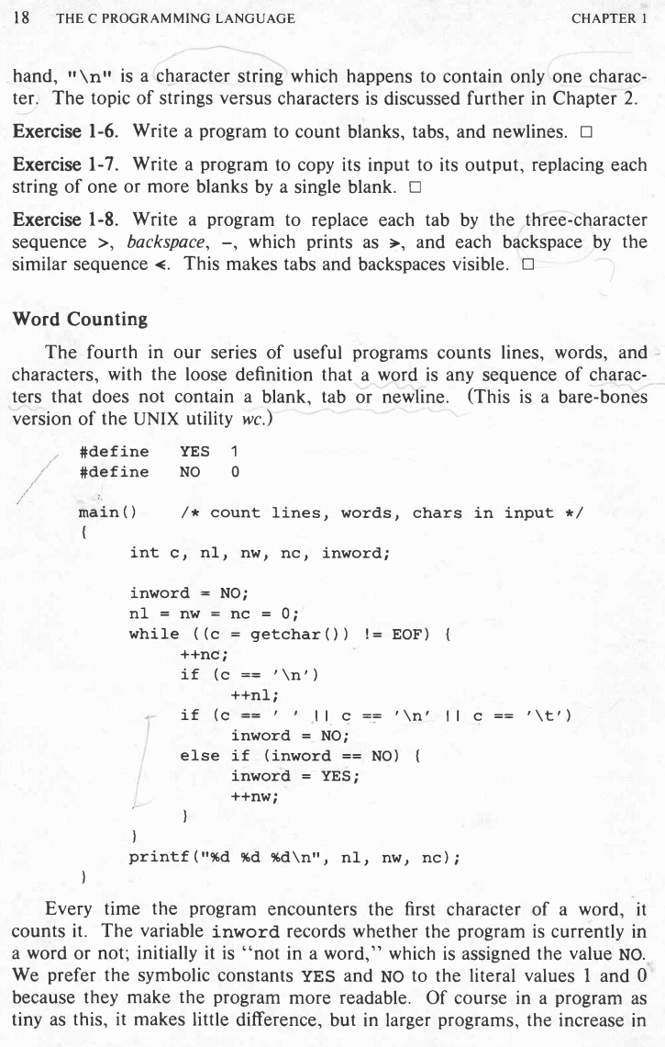
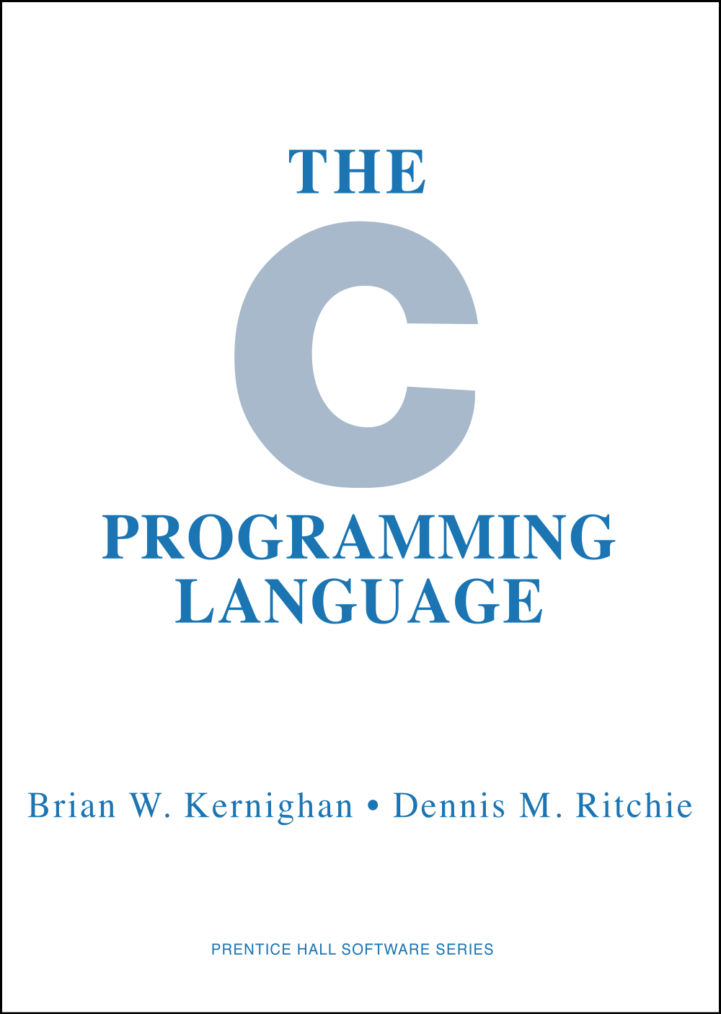
K&R - 1978

Slide 15
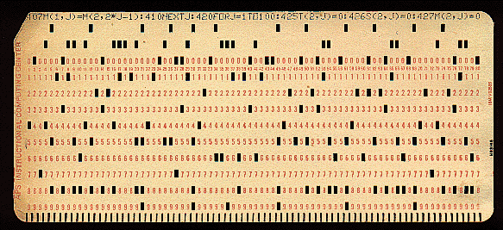
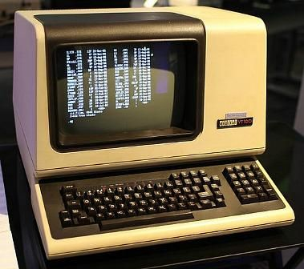
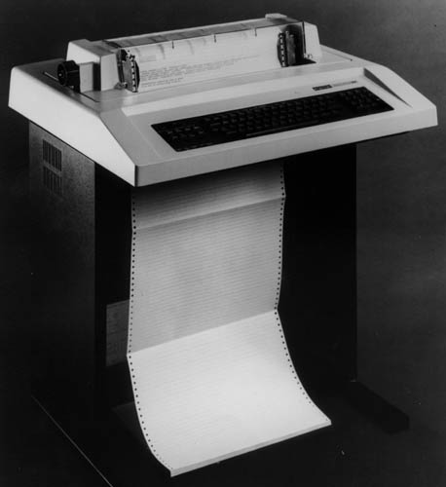
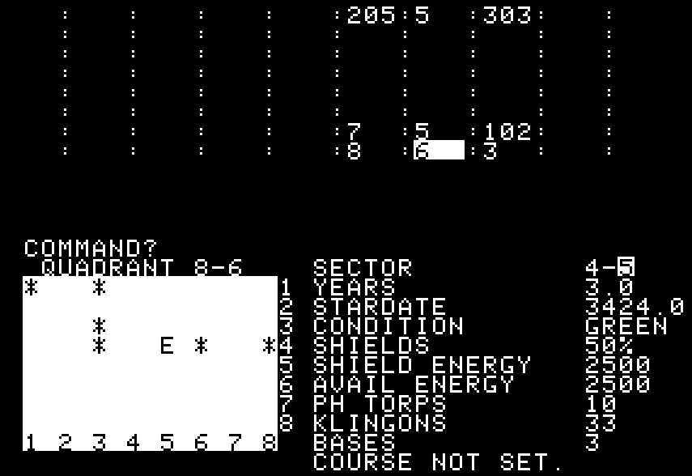
PunchCards, DecWriter and VT100

Slide 16
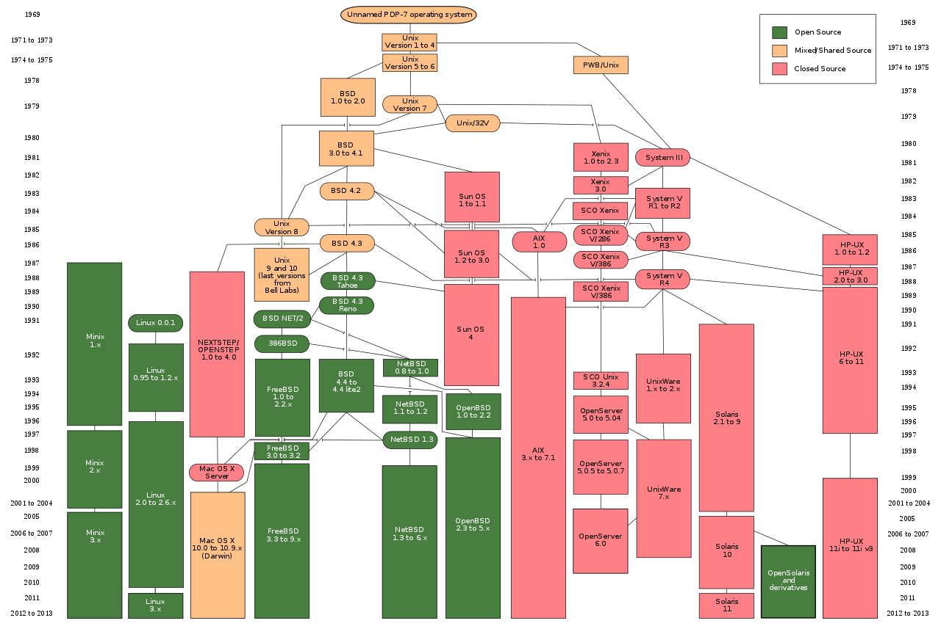
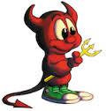






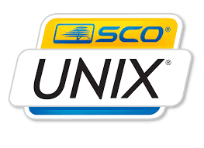
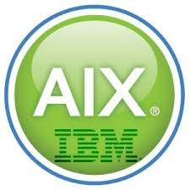
Unix Explosion

Slide 17
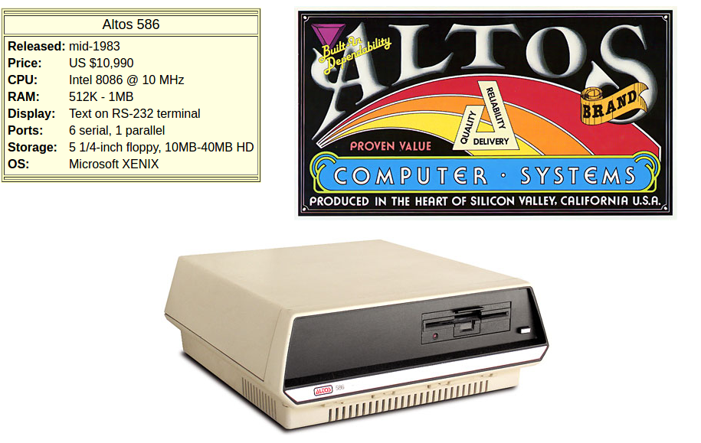
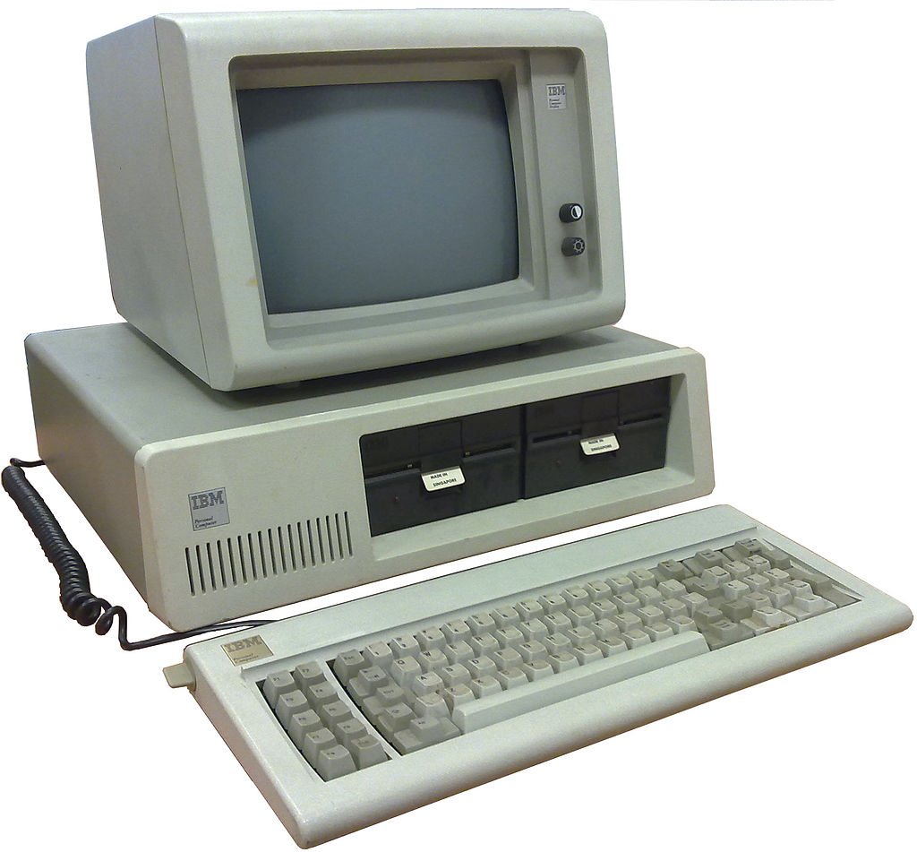
Microsoft Unix - XENIX
$23K in 2016
IBM PC 5150 – 1981
4.77MHz, 16k-256k
MSDOS
$6500 in 2016 dollars
5150 - Involuntary Psychiatric Hold

Slide 18

MaBell
1983
Anti-trust settlement broke up AT&T
Rush to commercialize, nearly killed Unix

Slide 19
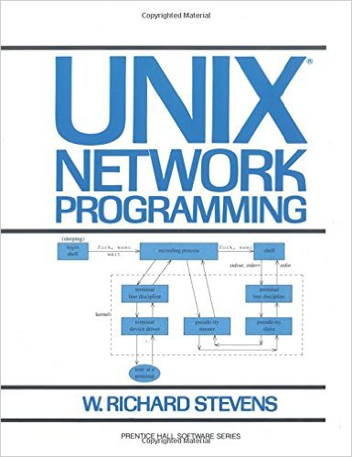
BSD gets TCP/IP - 1983

Slide 20
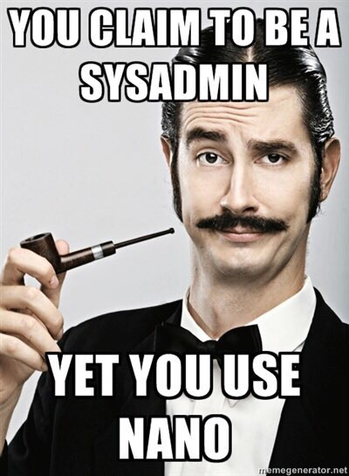
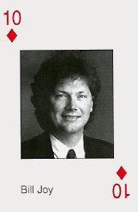
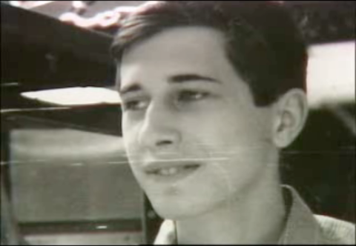
Editors
vi - Bill Joy develops
visual interface as a
UCB grad student
emacs - Richard Stallman sees WYSIWIG editor at Stanford AI Lab, returns to MIT, creates TECO with editing macros, emacs
Later creates GNU - “GNU's not Unix”

Slide 21
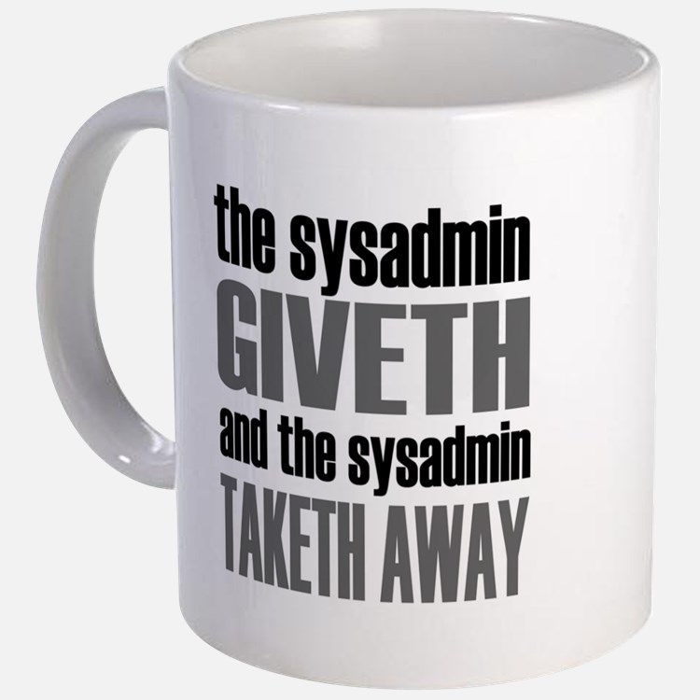
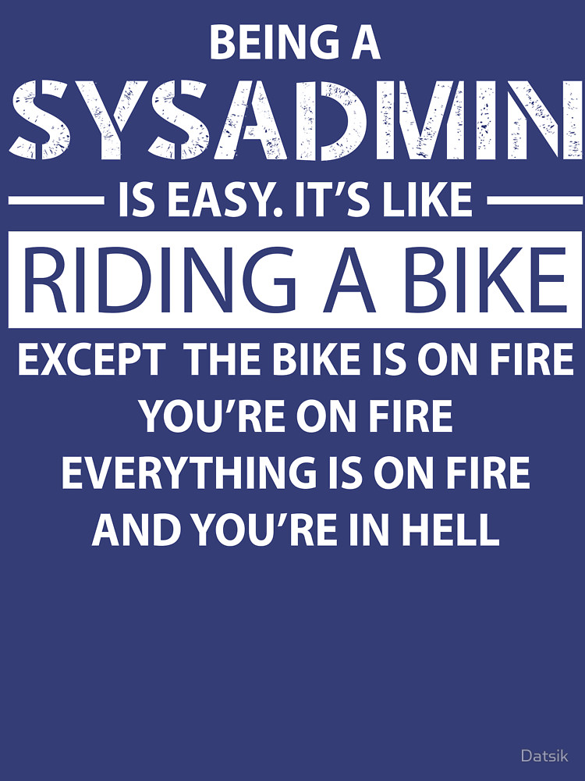
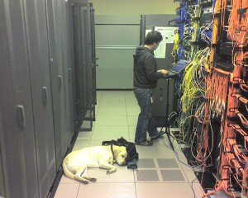
RTFM and apropos

Slide 22
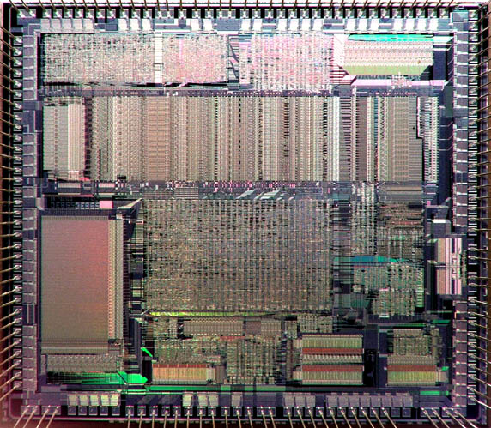
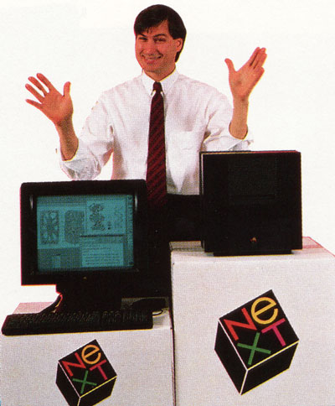
386&VM and What's Next? - 1985
275,000 transistors
$976 in 2016 dollars
RAM Price 512K $440
BSD, Mach, Darwin, later OSX

Slide 23
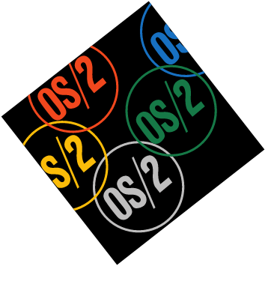
OS/2 Released - 1987
IBM and Microsoft join venture - has Unix and Xenix ties, later basis for NT

Slide 24
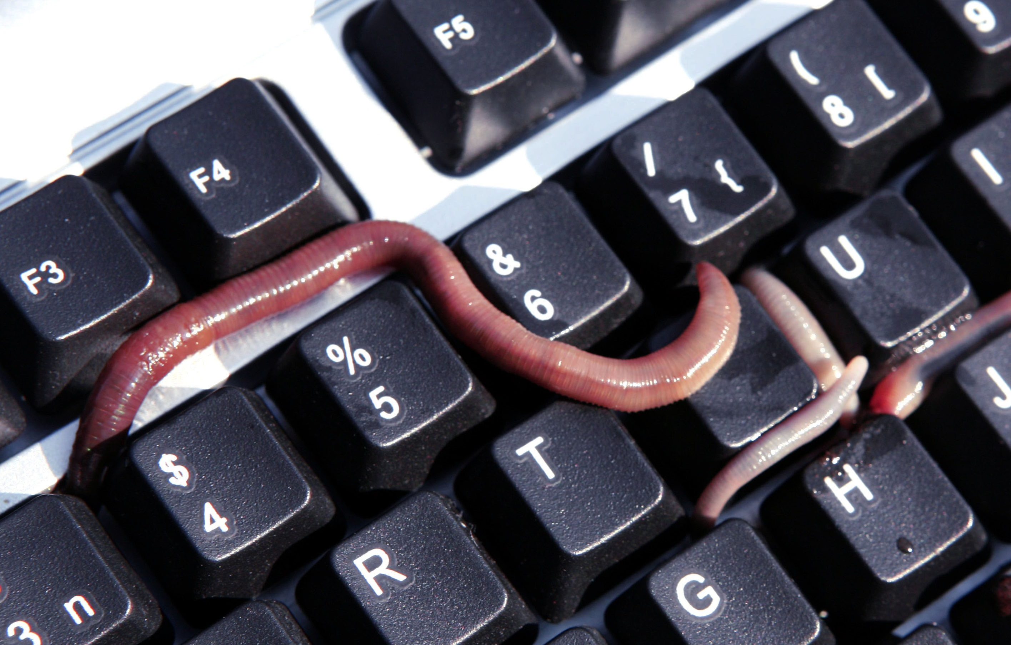
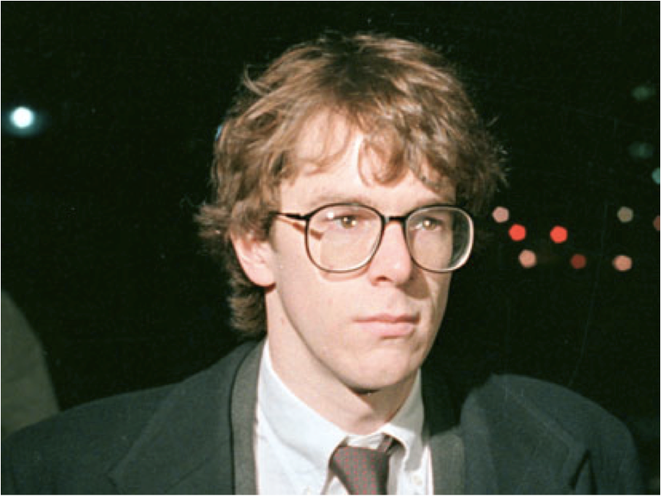
Morris Worm - 1988
One of the first worms distributed via the Internet.
Cornell student launched from MIT, infected 6000+ university, lab and government Unix computers in hours.
Damage estimate between $10M and $100M
Robert Morris first felony conviction under 1986 Computer Fraud and Abuse Act.
Currently an MIT professor.

Slide 25
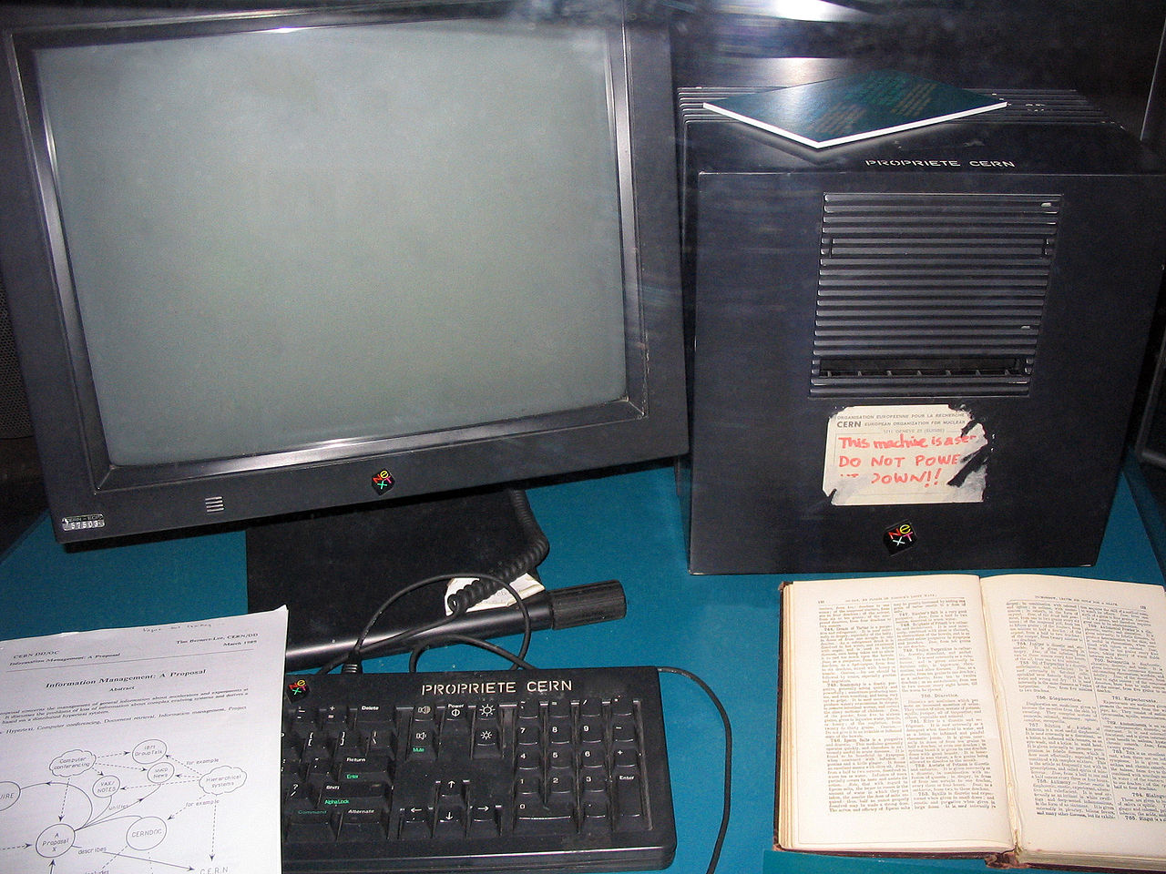
Webserver 0 - 1990
This original NeXT Computer was used by Tim Berners-Lee at CERN, and became the world's first Web server and ran the world's first Web browser in 1990

Slide 26

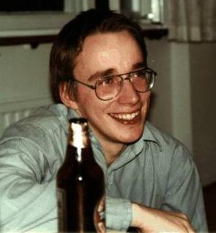
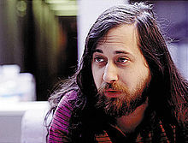
Linux Posted - 1991
From: torvalds@klaava.Helsinki.FI (Linus Benedict Torvalds)
Newsgroups: comp.os.minix
Subject: What would you like to see most in minix?
Summary: small poll for my new operating system
Message-ID: <1991Aug25.205708.9541@klaava.Helsinki.FI>
Date: 25 Aug 91 20:57:08 GMT
Organization: University of Helsinki
Hello everybody out there using minix –
I’m doing a (free) operating system (just a hobby, won’t be big and
professional like gnu) for 386(486) AT clones. This has been brewing
since april, and is starting to get ready. I’d like any feedback on
things people like/dislike in minix, as my OS resembles it somewhat
(same physical layout of the file-system (due to practical reasons)
among other things).
I’ve currently ported bash(1.08) and gcc(1.40), and things seem to work.
This implies that I’ll get something practical within a few months, and
I’d like to know what features most people would want. Any suggestions
are welcome, but I won’t promise I’ll implement them 🙂
Linus (torvalds@kruuna.helsinki.fi)
PS. Yes – it’s free of any minix code, and it has a multi-threaded fs.
It is NOT protable (uses 386 task switching etc), and it probably never
will support anything other than AT-harddisks, as that’s all I have :-(.
Linus Torvalds
1998, a confidential memo at Microsoft stated, "Linux is on track to eventually own the x86 UNIX market," and further predicted, "I believe that Linux - more so than NT will be the biggest threat to SCO in the near future."
Its “GNU/Linux”!, Stallman

Slide 27
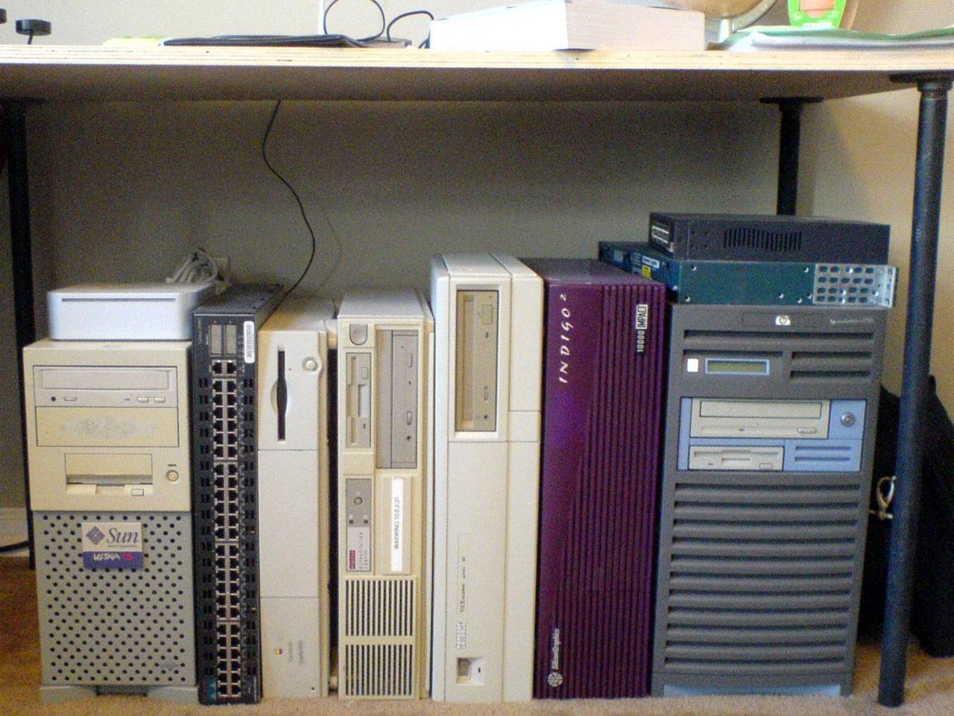
1995
NCSA httpd and a series of email patches
Netscape IPO, dot-com begins
SGI begins winning academy awards for visual effects
Abyss, Antz, Casper, Final Fantasy, Forrest Gump, Gladiator, Ice Age, Lord of the Rings, Jumanji, Jurassic Park 1,2,3, Shrek, Star Wars Ep1, Starship Troopers, Terminator 2, Hunt for Red October, The Matrix, Titanic, Toy Story, Twister and more

Slide 28
Unix Copyright Lawsuits
AT&T
Novell
SCO
Linux and IBM
1991 Linux announced
1993 AT&T sells Unix to Novell
1995 Novell sells Unix to SCO
1995 dot-com begins
2003 Was Unix source code in Linux?
2003 Microsoft funds SCO for $50M
2003 SCO sues IBM for $1 billion
2010 Novell owns Unix copyrights
2016 SCO vs IBM lawsuit dismissed

Slide 29
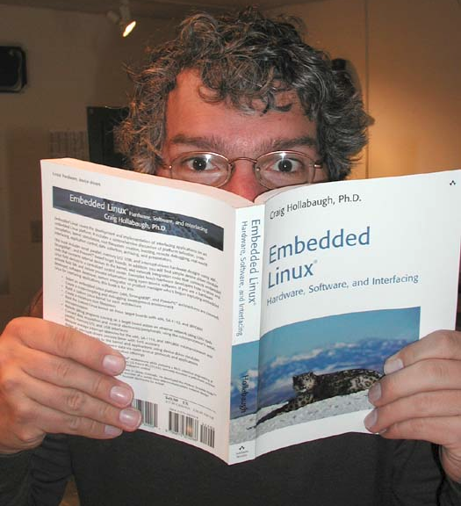
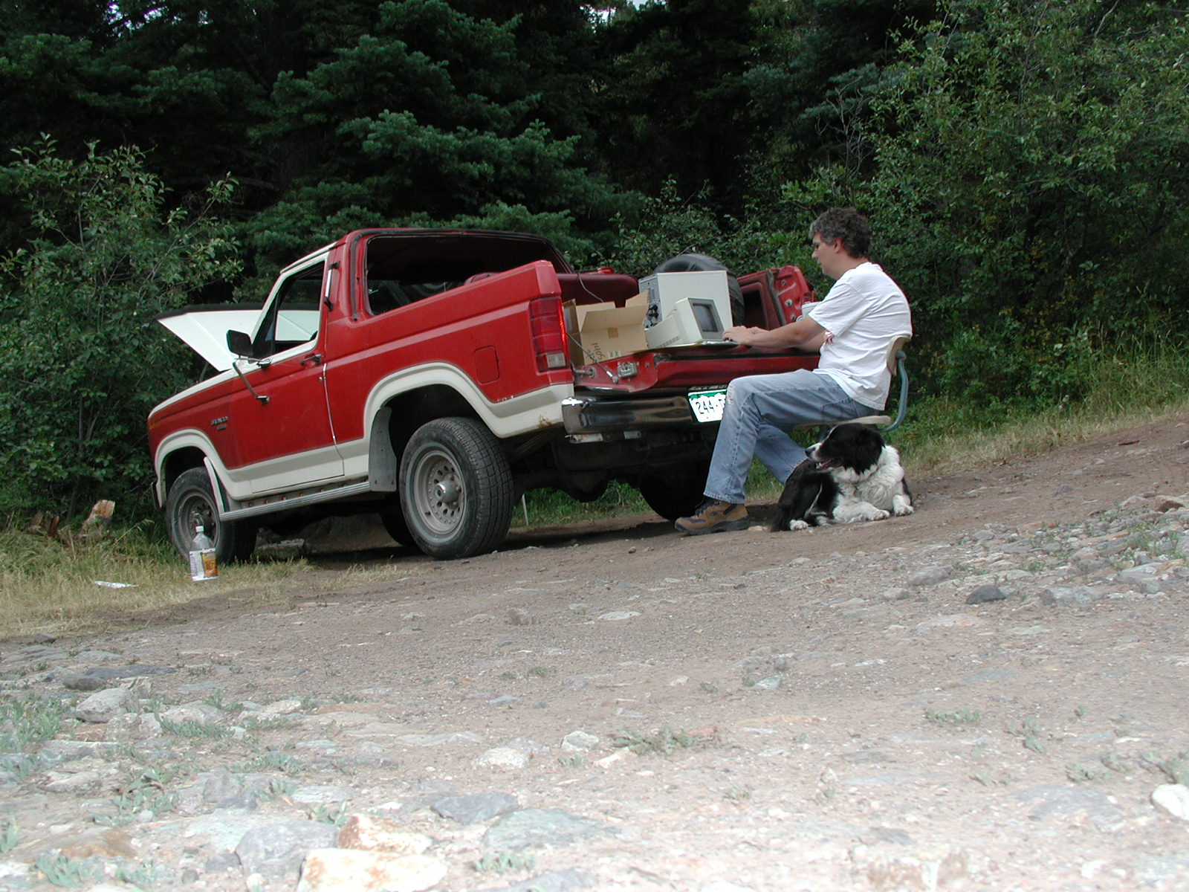
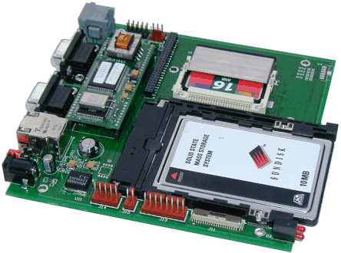
Embedded Linux - 2002
Addison/Wesley publishes Embedded Linux, hits Slashdot, goes to #5 on Amazon's computer book sales. Over 6 years, 10,000+ copies, translated into 5 languages.
BrightStar
MediaEngine
StrongARM 133MHz
8MB RAM 4MB Flash
$2200
The author and Jesse writing the raw text near Ouray campground.

Slide 30
2000s Fast Track
2003 googleplex takes over SGI's Mountain View location
2005 Torvalds gets pissed, creates GIT to distribute Linux src
2006 Google calls Craig ... “but we're google”, “so what?”
2007 iPhone released, loosely based on OSX
2008 Android released, uses Linux kernel
2009 Oracle buys Sun
2017 Oracle cans Solaris12

Slide 31
.em
Multics 1960s features exist today in all operating systems
Space Travel leads to UNICS
DOTADIW and KISS
RTFM
AT&T breakup nearly kills Unix
Many flavors of Unix
Student creates Linux
dotcom boom creates massive wealth
SCO sues, IBM wins, Unix wins, we all win
Unix lead to BSD, OS/2, NT, Darwin, OSX, Linux, WWW, iOS and Android

Slide 32
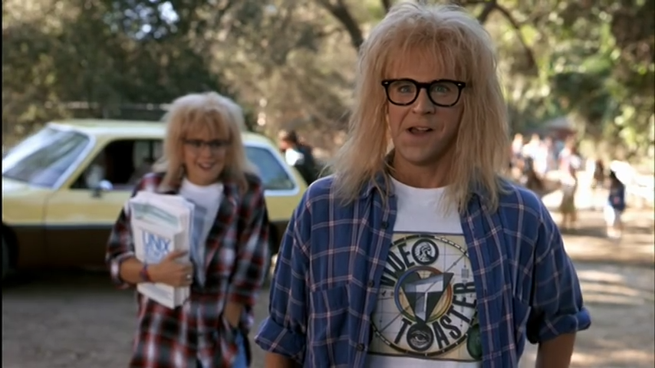
https://www.youtube.com/watch?v=hjjydz40rNI

